Slide 1
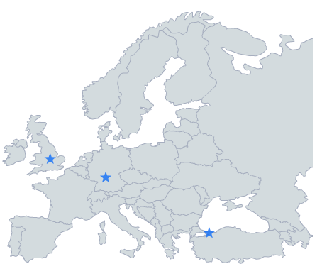

using external electronics on QD instruments
May 2013

Slide 2
outline
LabVIEW – MultiVu integration
new solution provided by QD!
other methods
A: (PPMS) other low level MultiVu commands
B: WinWrap Basic scripting in MultiVu
C: (PPMS) advisories

Slide 3
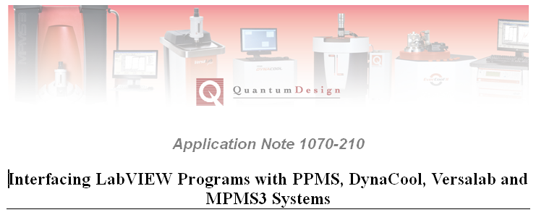
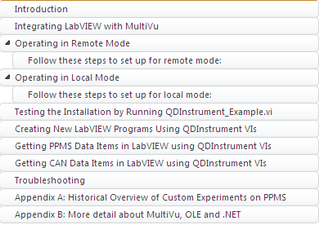
new LabVIEW – MultiVu package
Note is posted on website
www.qdusa.com
programs all attached in:
QDInstrument_LabVIEW.zip

Slide 4
setup examples
remote mode
local mode
LCR meter
DynaCool
DynaCool
electronics
LCR meter
Model 1000
PPMS
Model 6000
USB
LabVIEW
CAN
GPIB
GPIB
CAN
QDInstrument VIs
MultiVu
LabVIEW
MultiVu
LAN
QDInstrument_server.exe
QDInstrument VIs
QDInstrument.dll
LabVIEW PC
MultiVu PC
QDInstrument.dll
MultiVu PC
LCR meter
PPMS
Model 1000
Model 6000
We translate between:
.NET
LAN
OLE
GPIB
LabVIEW
GPIB
CAN
QDInstrument VIs
MultiVu
LAN
QDInstrument_server.exe
QDInstrument.dll
LabVIEW PC
MultiVu PC

Slide 5
why we like this new package
MultiVu is running
essential communications hub, needs to run!
can be used on all QD equipment (except MPMS)
uses MultiVu OLE interface
enjoys safeguards built into MultiVu
remote mode leaves MultiVu PC undisturbed
backward compatible to LabVIEW 8.2
QDInstrument.DLL can be accessed from other languages
for advanced programmers who have their favorite

Slide 6
important note!
previous LabVIEW packages available from QD customers posted to web
use direct GPIB commands to Model 6000
not recommended
conflicts w/ MultiVu, requires MVu to be stopped
limited to PPMS
can’t use He-3, DR, hybrid magnet controller

Slide 7
PPMS: controlling an option
A
Model
6000
measurement
MultiVu built-in
commands
MultiVu
User
Bridge
Visual Basic
macro
B
WinWrap scripting
option
software
option
electronics
A
sample
B
Notes:
This shows all the ways of interfacing with your measurement sample in the PPMS sample chamber.
Note that the option software is generally the only connection to the option hardware.
Method A: usual method of measuring live or in a sequence. The user can communicate with the option electronics and the Model 6000 more generally.
Method B: the NEW integrated Visual Basic editor for VB macros in MultiVu allows the user much more programming power. VB editor only in MultiVu 1.5.0 or later.
Dashed line around option software and around lower B: VB macros in MultiVu will in the future be able to control measurement options. For example, doing an ACT or VSM measurement using a macro. However, this is not yet implemented. More on this later

Slide 8
using 3rd party electronics (no LabVIEW)
A
Model
6000
MultiVu
B
advisories
C
User
Bridge
Visual Basic
macro
external
user-
written
program
B
A
3rd party
instrument
sample
measurement
Notes:
Method A is still applicable when using a 3rd party instrument: note the connection between MultiVu and 3rd party instrument goes through the Model 6000. There are several ways of sending analog and digital signals between the two, which can make it simpler for the user because no external programming (method C) is required. These methods are descibed on the next slide.
Method B: the VB editor can use general GPIB and CAN commands, so communication with the 3rd party instrument is quite easy. This has the advantage that it is still within MultiVu. Users are already sharing programs to control bridges, lock-ins, and LCR meters using VB macros.
Method C (advisories): traditional way of communicating with 3rd parties, this involves writing a program (C++, VB, Delphi, LabView) outside of MultiVu that controls the instrument. Advisories are the only way to coordinate the external program with MultiVu, and are a one-way communication from MultiVu. The dashed line indicates this strong separation between MultiVu and the program.

Slide 9
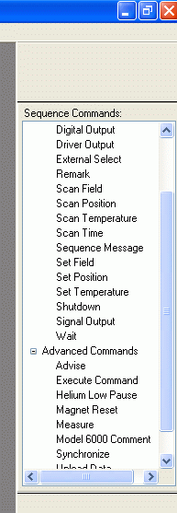
method A outputs
via MultiVu
interactive
in sequence
digital outputs
(P-8) 3 lines with 0/-24V setting
(P-11) 3 lines with 0/5V
analog outputs
(User Bridge) driver 1 or 2
up to 1 A, 20 W
(4x BNC) -10 to +10 V
can also map system parameters
Notes:
Method A is the standard way of getting data from the Model 6000, but you may not realize much of the general utility built into the Model 6000.
It can interface with external instruments by triggering it with digital outputs.
The Model 6000 can also act as a general tool for providing current or voltage to your experiment.
Please read PPMS Hardware manual (Appendix A) and PPMS MultiVu manual for more information on the powerful tools built into the Model 6000.

Slide 10
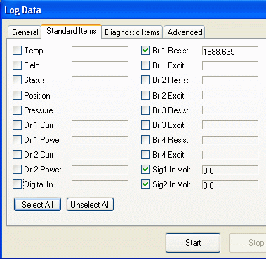
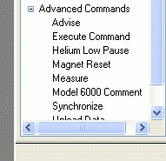
method A inputs
analog inputs
(User Bridge) 4x voltmeter channels
-95 mV to +95 mV
20 nV rms noise level
see app note 1076-303
(P-8) 2x -10V to +10V
10-bit A/D
digital inputs
(P-11) Synchronize
halts sequence execution until digital signal received
Notes:
See application note 1076-303 on using User Bridge channels in voltage mode.
analog inputs can be accessed in the PPMS Log Data.
Part of the “PPMS log data” dialog is shown in upper right to illustrate how you collect this data.
synchronize is used together with External Select.

Slide 11
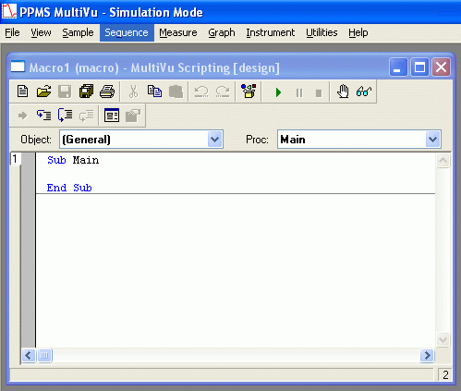
WinWrap Basic: method B
internal to MultiVu
Sequence > Advanced > Edit Macro
examples exist
PPMS input/output
data file handling
.OBM files there for
lockins
bridges
LCR meters...
library is growing
see app note 1070-209 on web
NOTE: WinWrap currently only addresses one GPIB card
3rd party equipment on PPMS should use another bus (USB, Ethernet..)
QD working to fix this

Slide 12
Advisories: method C
see PPMS application note 1070-202 on QD website
user has freedom to choose programming language
not integrated with MultiVu
advisories are only link
can be done in combination with method A
analog data sent to Model 6000, logged in MultiVu
we recommend to use PPMSCOMM.dll to coordinate communication with Model 6000
otherwise conflicts result between program and MultiVu
see Pharos

Slide 13
Summary
if using LabVIEW, see new app note
methods within MultiVu also available
(PPMS) low-level MultiVu commands
WinWrap Basic scripting
Advisories

